Slide 1

Drug Persistency Project
Virtual Internship: Final Presentation
Group Name: Health+
Group Members:
Mohammad Odeh (United Arab Emirates)
Sakib Mahmud (Qatar) Date: 11-May-2021

Slide 2
Background – Drug Persistency case study
One of the challenge for all Pharmaceutical companies is to understand the persistency of drug as per the physician prescription. To solve this problem ABC pharma company approached an analytics company to automate this process of identification.
Objective : Gather insights on the factors that are impacting the persistency, build a classification for the given dataset.
The analysis has been divided into three parts:
Data Understanding
Data insights and visualization
Recommendations

Slide 3
Data Exploration
68 Features, including :
General features such as (Demographics, Provider Attributes)
Diseases/Drugs Factors
Clinical Factors
Total number of patients : 3424
Assumptions:
The data follows Normal Distribution.
Patients’ history data were recorded accurately without any errors in testing or examination.

Slide 4
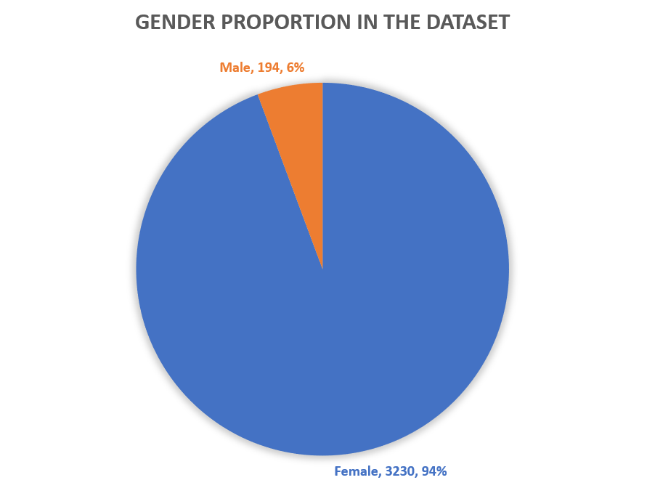
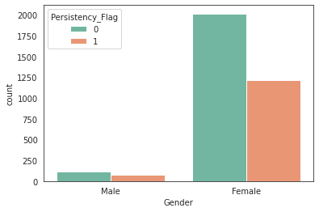
Profit Analysis
Demographics Analysis
Gender Proportion
Gender Proportion vs. Persistency Flag

Slide 5
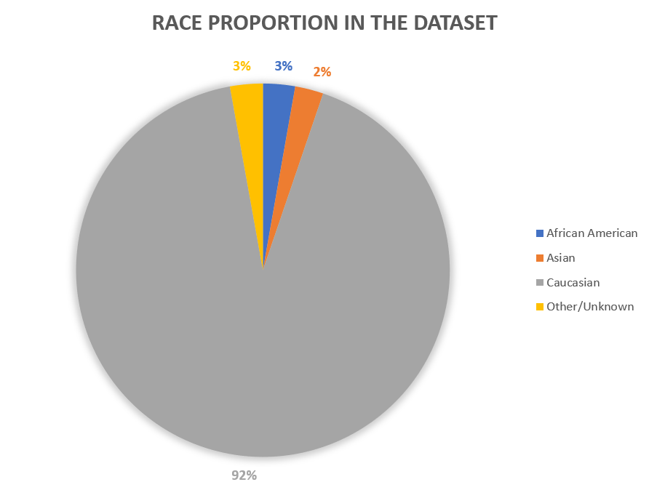
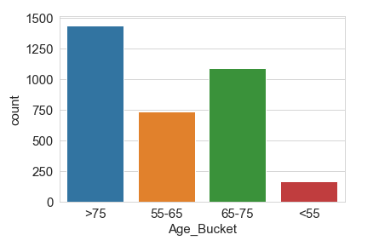
Profit Analysis
Demographics Analysis
Age Proportion
Age Bucket vs. Persistency Flag

Slide 6
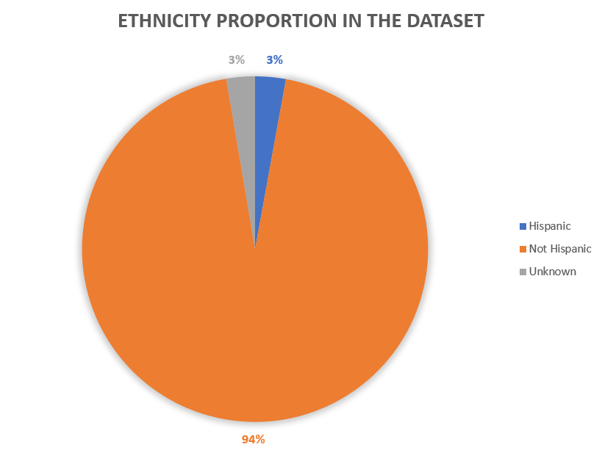
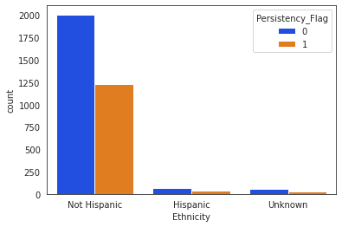
Profit Analysis
Demographics Analysis
Ethnicity Proportion
Ethnicity vs. Persistency Flag

Slide 7
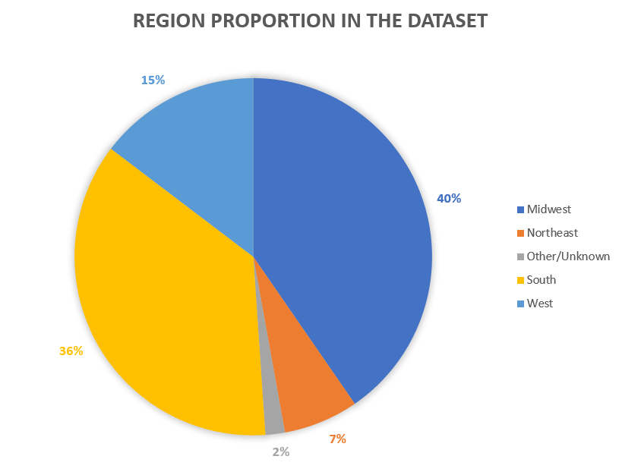
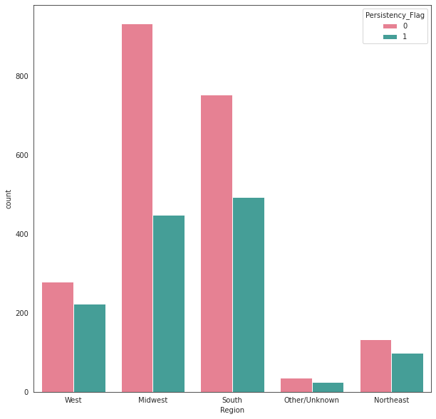
Profit Analysis
Demographics Analysis
Region Proportion
Region vs. Persistency Flag

Slide 8
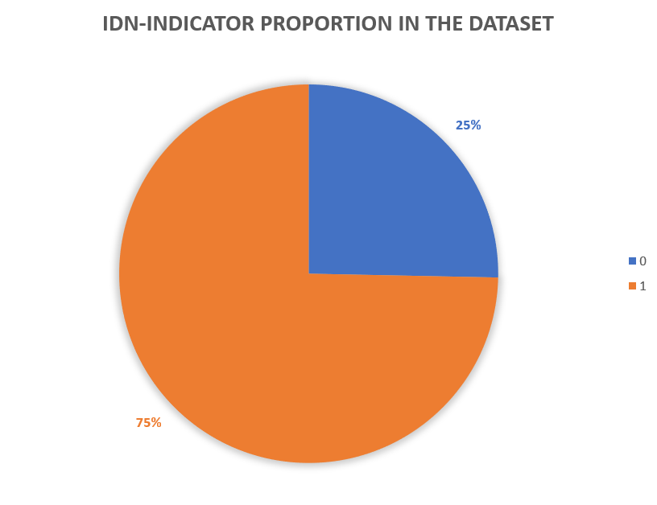
Profit Analysis
Demographics Analysis
Race Proportion
IDN Indicator Ratio

Slide 9
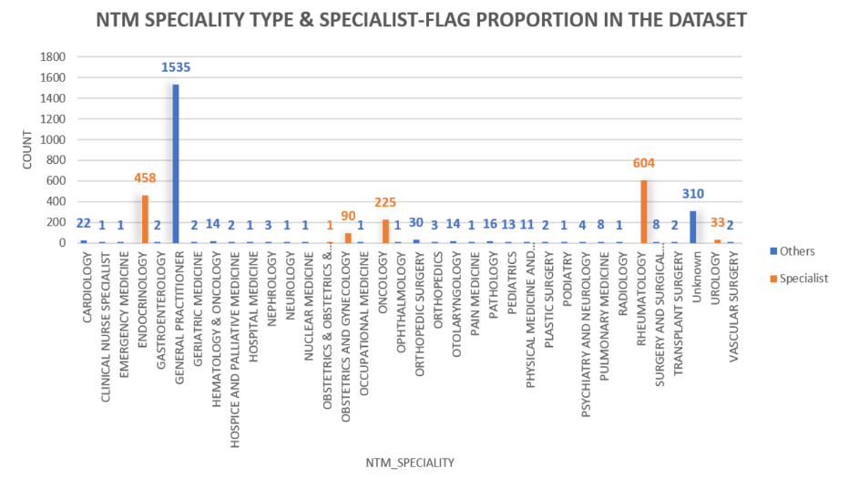
Disease Type and Responsible Physician Specialty Analysis

Slide 10
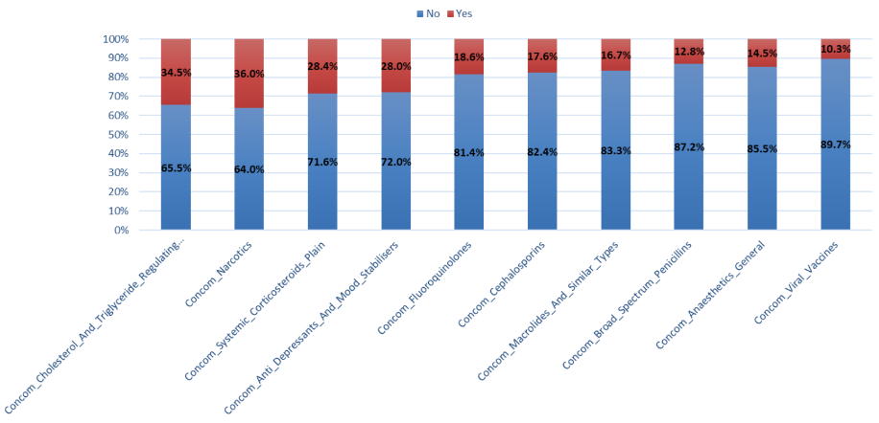
Drug Factor Analysis
Concomitancy of Drugs

Slide 11
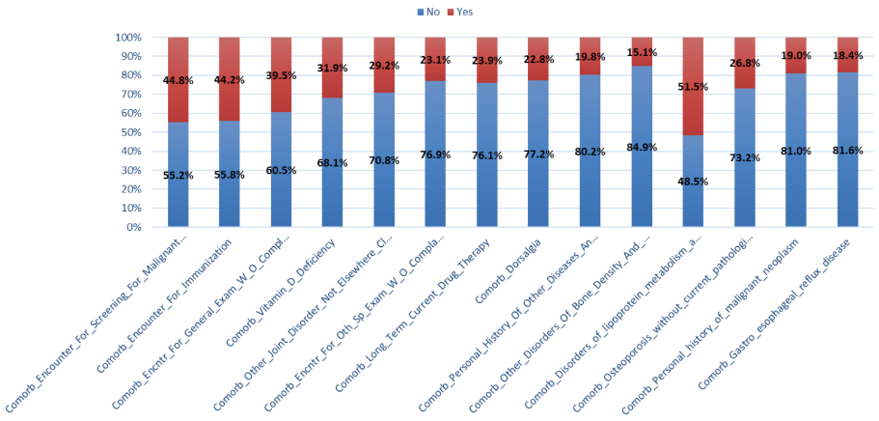
Diseases Factor Analysis
Comorbidity of Diseases

Slide 12
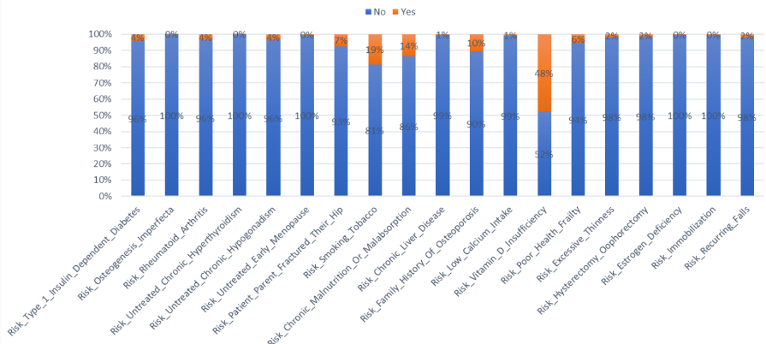
Risk Factor Analysis
Risk Factors

Slide 13
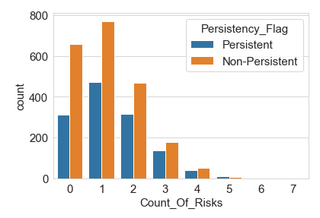
Risk Factor Analysis
High number of non persistent patients has less than 3 count of risks.
Patients with more than 3 count of risks has the highest percentage of non-persistent cases compared to total registered cases.
Risk Counts Vs Persistency Flag

Slide 14
Risk Factor Analysis
High number of non persistent patients has less than 3 count of risks.
Patients with more than 3 count of risks has the highest percentage of non-persistent cases compared to total registered cases.
Risk Counts Vs Persistency Flag

Slide 15
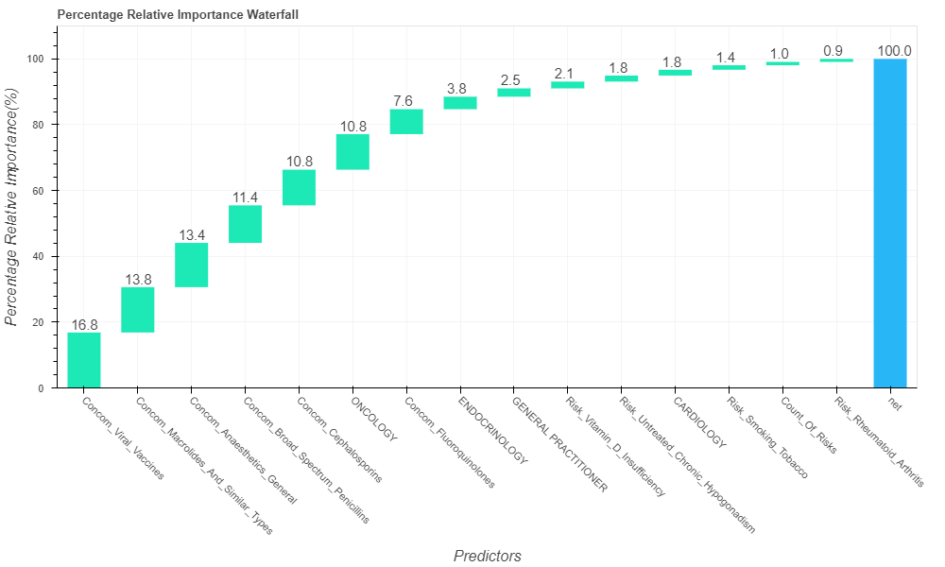
Dominance Analysis
Dominance Analysis show most influential features in the data set (Most 15 influential factors).
It can be noticed that clinical parameters were the most influential factors behind persistency of drugs.

Slide 16
Recommendations
From the Exploratory Data Analysis (EDA) done on the dataset, following recommendations are given to the ABC company’s technical team:
Demographic Factors provided in the dataset is not strongly related to the “Persistency Level” of the patients.
NTM Specialist type or Specialist Flag did not show any correlation to the target variable.
Some important parameters were determined using Dominance Analysis which can be used to transform the dataset into a subset and perform quantitative analysis.
Clinical Factors such as “Concomitancy of Drugs”, “Comorbidity of Various Diseases” and “Risk Factors” do show some correlations with the target variable “Persistency Level” of the patients which needs to be investigated further through a Quantitative Analysis such as Machine Learning.

Slide 17
Recommendations

Slide 18
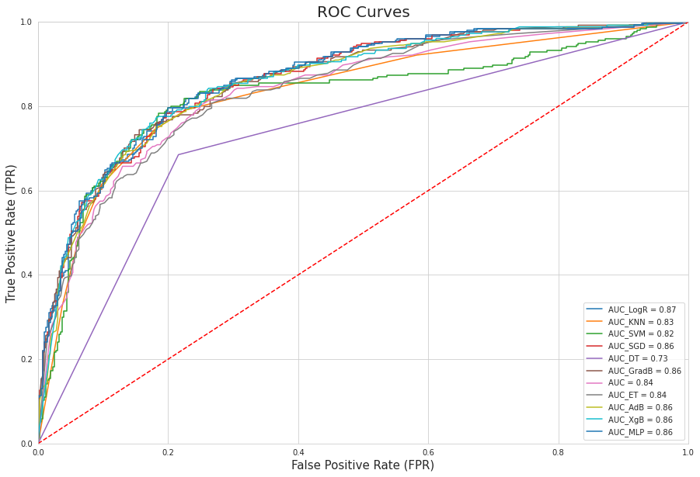
Recommendations

Slide 19
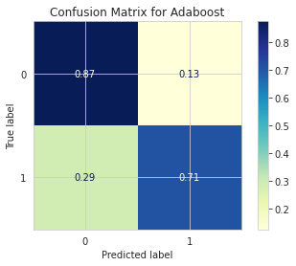
Recommendations

Slide 20
Recommendations
Based on the provided data ( mostly categorical ), and the previous analysis we recommend 2 types of model to build for this problem:
Neural Networks
Adaptive Boosting (Ensemble)
Gradient Boosting (Ensemble)
Both should be complex enough to learn well the data and provide high accuracy
Selected Pipeline: Autoencoder based feature extraction

Slide 21
Thank You

